Slide 1
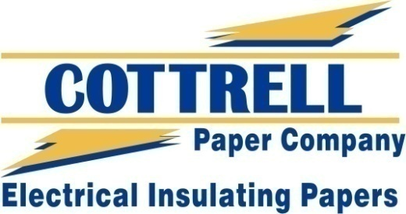
100% Hemp Machine Made Papers
For Use In Specialty Packaging and Printing
Printed on 100% Cottrell Hemp
-PRODUCT FEATURES-
Renewable
1 acre of Hemp can produce as much paper as 4-10 acres of trees over a 20- year cycle, and hemp doesn't need pesticides or herbicides.
Higher Cellulose Content
Trees are made up of only 30% cellulose, requiring the use of toxic chemicals to remove the other 70%. Hemp, on the other hand, can have up to 85% cellulose content.
Lower lignin content
Hemp has lower lignin content than wood. Hemp contains 5-24% lignin whereas wood has 20-35%. This is advantageous as lignin must be removed from the pulp before it can be processed as paper.
Durable
Hemp paper is more durable than trees and does not yellow, crack, or deteriorate like tree paper. It is also one of the strongest natural fibers in the world, one of the reasons for its longevity and durability.
Non Toxic Whitening
Hemp paper does not require the use of toxic bleaching or as many chemicals as wood pulp because it can be whitened with hydrogen peroxide which is consumed in the process.
Recyclable
Hemp paper can be recycled up to 8 times, compared to just 3 times for paper made from wood pulp. It is also compostable and biodegradable.
More stretch
100% machine made hemp paper produced by Cottrell has more stretch built into it in both directions allowing it to be folded without the risk of cracking. This special process also greatly increases the ability of the paper to absorb energy without breaking when stressed.
www.cottrellpaper.com Responsive ▪ Reliable ▪ The Right Choice 1-800-948-3559

